Slide 1
Jermyn Borough Council Meeting
1/21/21

Slide 2
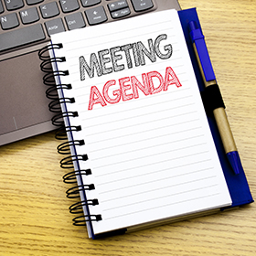
Meeting Agenda
Call to Order
Pledge of Allegiance
Roll Call
Previous Meeting Minutes
Treasurer’s Report/Bills Payable
Correspondence
Public Comment
Professional Reports
Committee Reports
Borough Manager Report
Rental Permit Ordinance
Washington Ave. Speed Limit Reduction Ordinance
2021 Fee Resolution
Unoccupied Structures Ordinance
Lackawanna County Assistance Programs
New Business
Adjournment

Slide 3
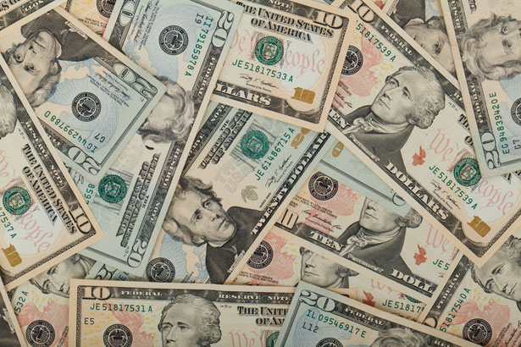
Treasurer’s report
1/21/21
ASSETS
Capital Reserve - DPW 13,497.72
Capital Reserve - Police 3,375.05
Crime Watch Fund 755.44
General Fund - Community 85,101.81
General Fund - FNB 1,976.22
Holiday Lights Fund 543.90

Slide 4
Treasurer’s report
Investment - General Fund 1,001.39
Investment - Liquid Fuels 33,808.80
Investment - Paving Fund 11.91
Investment - Recycling 5,002.66
Investment - Refuse 2,604.51
Liquid Fuels - FNB 22,036.47
Petty Cash 171.42
Recreations Fund 9,773.12
Recycling - Community 9,109.37
Refuse Checking - FNB 36,333.40
Total Checking/Savings 225,103.19

Slide 5
TREASURER’S REPORT
Accounts Payable 26,943.88

Slide 6


